Slide 1
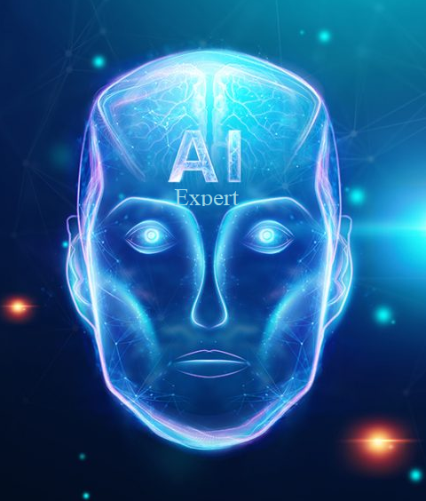
1. 2 A I E X P E R T C O U R S E T O U R
s
S r i r a m - I T E x p e r t
Y o u t u b e C h a n n e l : I n t e l l e c t S r i r a m

Slide 2
Artificial Intelligence Expert – Course Tour
AI Expert Course Tour
Learning Objectives
Becoming an Artificial Intelligence Expert puts you on the path to an exciting, evolving career that is predicted to grow sharply into 2020 and beyond. Artificial intelligence will impact all segments of daily life by 2025, with applications in a wide range of industries such as banking, insurance, healthcare, retail, transport and logistics and even customer service.
Current AI Market Trend
The New York Times reports a candidate shortage for certified AI Engineers, with fewer than 10,000 qualified people in the world to fill these jobs, which according to that, an average salary of $172,000 per year in the U.S. for engineers with the required skills.

Slide 3
Artificial Intelligence Expert – Course Tour
AI Expert Course Tour
Skills you will learn
Design and build your own intelligent agents and apply them to create practical machine learning models, logic constraint satisfaction problems, knowledge-base systems, probabilistic models.
Understand and master the concepts and principles of machine learning, including its mathematical and heuristic aspects.
Implement deep learning algorithms in keras backend with TensorFlow.
Understand neural networks, empowering you to analyse and utilize data in a better way.
Master advanced topics such as convolutional neural networks, recurrent neural networks, training deep networks and high-level interfaces
Learn about major applications of Artificial Intelligence across various use cases in various fields like customer service, financial services, healthcare etc.,
Ability to apply Artificial Intelligence techniques for problem-solving and explain the limitations of current A I techniques

Slide 4
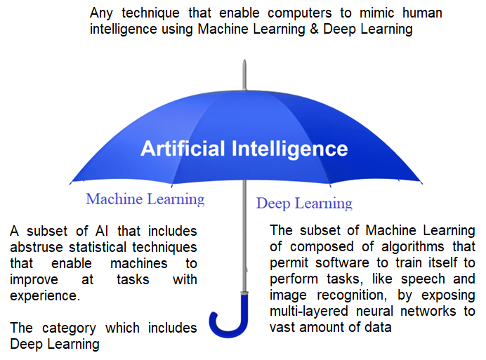
AI Umbrella
AI Expert Course Tour
Deep Learning uses neural networks to simulate human like decision making

Slide 5
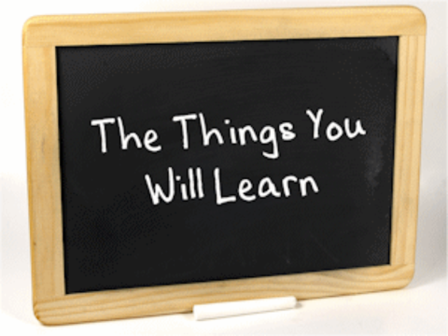
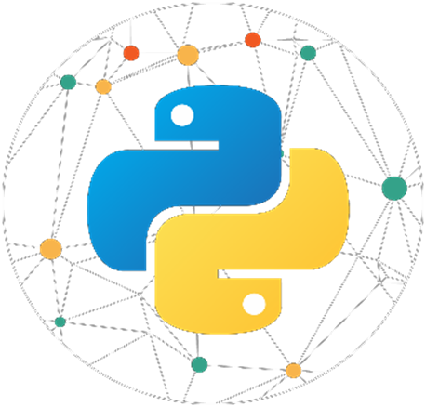
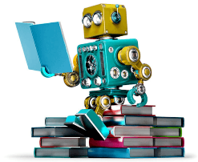

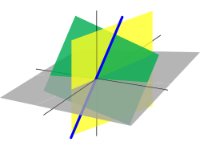
Course Coverage
AI Expert Course Tour
Python
Machine Learning
Statistics
Linear Algebra
Deep Learning

Slide 6
Course 1 – Python Programming Topics
AI Expert Course Tour
1. Python 101
2. Python Basics
3. Flow Control
4. String Manipulation
5. Data Structures in Python
6. Functions, Modules and Packages
7. File Handling
8. Error and Exception Handling
9. OOPS Concepts
10 Python Numpy
11. Python Pandas
12. Python Matplotlib
13. Python SciPy
14. Python Seaborn
15. Database Programming in Python
16. Web Python

Slide 7
Course 2 – Statistics & Linear Algebra Topics
AI Expert Course Tour
Statistics
1. Foundations of Statistics
Measures of central tendency (mean, median, mode )
Measures of central dispersion (range, variance std deviation)
2. Probability
Rules
Types,
Bayes theorem
Distribution
Linear Algebra
1. Matrices and Vectors
2. Addition and Scalar Multiplication
3. Matrix Vector Multiplication
4. Matrix Multiplication
5. Matrix Multiplication Properties
6. Inverse and Transpose

Slide 8
Course 3 – Machine Learning Topics
AI Expert Course Tour
1. Machine Learning 101
2. Data Preprocessing
3. Supervised Learning
4. Unsupervised Learning
5. Reinforcement Learning
6. Associative Rules Mining and Recommendation system
7. Dimensionality Reduction
8. Time Series Analysis
9. Model Selection & Boosting
10. Natural Language Processing

Slide 9
Course 3 – Machine Learning Model Topics
AI Expert Course Tour
Supervised Learning
Linear Regression –> Regression
Logistic Regression –> Classification
Naive Bayes –> Classification
Support Vector Machine -> Classification and Regression
Decision Tree –> Classification and Regression
Random Forest –> Classification and Regression
Unsupervised Learning
K-means –> Clustering
KNN –> Clustering
Hierarchy Clustering –> Clustering
Model Selection & Boosting
AdaBoost –> Ensemble Method
Reinforcement Learning
Upper Confidence Bound
Thompson Sampling
Natural Language Processing
LDA –> Topic Modeling
TF-IDF –> Topic Modeling
Associative Rule Learning
Eclat – Associative Learning
Apriori - Associative Learning
Dimensionality Reduction
PCA – Dimensionality Reduction

Slide 10
Course 4 – Deep Learning Topics
AI Expert Course Tour
1. Deep Learning 101
2. Understanding Neural Network
3. Conventional Neural Network
4. Recurrent Neural Network
5. Restricted Boltzmann Machine and Autoencoders
6. Keras
7. TFLearn

Slide 11






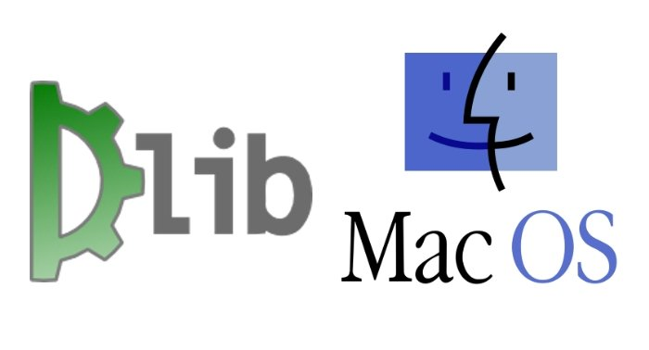

Tools Coverage
AI Expert Course Tour
Python Libraries
Web Framework | Desktop Tools

Slide 12
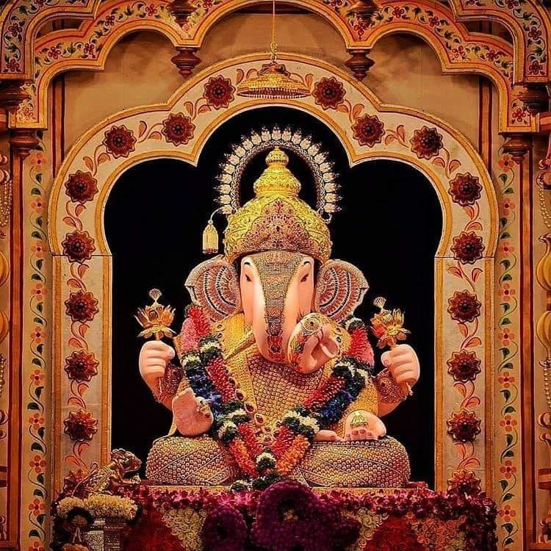

T h a n k Y o u !
I n t e l l e c t S r i r a m
Subscribed
LinkedIn : https://www.linkedin.com/in/sriram-balasubramanian-374566166/
GitHub : https://github.com/intellectsriram

